Slide 1
Methods of Control
Topic Three

Slide 2
Q1: What is POWER? Q2: Which country is the most powerful in international politics today?

Slide 3
Some Power Rankings
Soft Power measures
Hard power measures
RANK | Military Spending | Armed Forces | Economic Size | Wealth | Exports | Imports | Most traded currency | Top 20 universities
1 | US | China | US | Luxembourg | China | US | US (44%) | US (75%)
2 | China | India | China | Switzerland | US | China | EU (16%) | UK (20%)
3 | India | US | Japan | Ireland | Germany | Germany | Japan (11%) | Canada (5%)
4 | UK | N. Korea | Germany | Norway | Japan | Japan | UK (7%)
5 | Russia | Russia | UK | US | Netherlands | UK | Australia (3.5%)
6 | France | Pakistan | India | Singapore | S. Korea | Netherlands | Canada (2.65%)
7 | Germany | Vietnam | France | Australia | Italy | France | India
8 | Saudi Arabia | Egypt | Italy | Denmark | France | India | China (2%)
9 | Japan | Myanmar | Canada | Qatar | Belgium | S. Korea | Sweden (1.1%)
10 | S. Korea | Indonesia | S. Korea | Sweden | Canada | Mexico | New Zealand (1.09%)
Notes:
US = 81 China = 55 Russia = 4 Germany 48

Slide 4
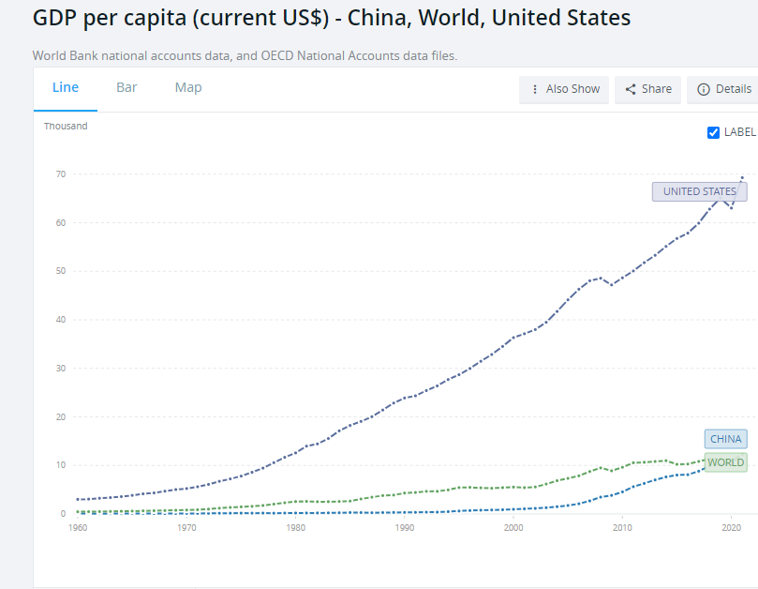

Slide 5
Q: In the conflict between the U.S. and China over Human Rights issues inside China, which is most likely to win? Q: Why?

Slide 6
Q: In the conflict between the U.S. and North Korea over North Korea’s determination to continue developing nuclear weapons…which is going to win?

Slide 7
Key Concepts about forms of control causing an intended change in behavior

Slide 8
Flooding
Observer
Police
Car

Slide 9
Coercion = use of force by A to get B to do something it didn’t want to do

Slide 10
Power = use of the threat of force by A to get B to do something it didn’t want to do

Slide 11
Influence = for A to change B’s behavior by any other means short of power or coercion

Slide 12
Q: Is imposing economic sanctions an act of power, coercion or influence?
e.g. Imposition of economic sanction by the U.S. on Iran or North Korea; sanctions on Russian Federation

Slide 13
Strength = resources with which to try to control the behavior of others Unilateral strength Relational strength Structural strength

Slide 14
Korean war
Notes:
Unilateral strength

Slide 15
Relational Strength: Major Powers
Notes:
Relational Strength

Slide 16
Notes:
Structural Strength = dealing with size and complexity of entire international system

Slide 17
Autonomy vs. Dependence in Resources
Notes:
Witness German role in Ukraine; caution regarding China

Slide 18
Where does State Strength Come From?
Internal Sources External Sources
Economy (GDP) -- Alliances
Extraction -- External resources
(Will) (e.g. Crimea)
State competence
(=Q of G; Corr.) --Aid (resource transfers)
Strength
Notes:
This is how self help works

Slide 21
Puzzle: In the conflict between Iran and Israel, why does Iran use proxies while Israel directly attacks Iran?
There have been no direct Iranian attacks on Israeli soil but key Israeli attacks on Iranian territory
Notes:
Can this be explained by their relative strength?

Slide 22
= Iran w/ @ 30-35% of military strength
Notes:
STOPPED AT THE END OF THIS

Slide 23
Sources of Control
Coercion: military capabilities + ability to mobilize them
Power: same + CREDIBILITY
3) Influence: more subtle; at least 3 types—
Material: economic resources
Cultural: cultural affinity responsiveness
Interactional/Developmental: prestige, trust, expertise, reputation (Nye’s soft power)

Slide 24
What you need to know to use methods of control:
Resources Motivation Competence
A B
Value placed on preferences
Resources available for situation
Past history of success/failure
Future desire for preference(s)
RELATIVE BALANCE FOR EACH: cost versus benefits
Notes:
Ukraine/Russian war as example

Slide 25
Keep in Mind: Control is a function of --Resources (strength) + --Motivation (depending on issue) + --Competence --Other side’s (?) resources, motivation, competence NO SUCH THING AS MOST POWERFUL

Slide 26
If Resources alone were to decide the outcome of conflicts:
Russian Capabilities versus Ukraine capabilities
4 to 1 advantage in size of military personnel;
10 to 1 advantage in air forces;
17 to 1 advantage in infantry fighting vehicles
11 to 1 advantage in military spending
9 to 1 advantage in economic size

Slide 27
Capabilities degraded by ineffective governance and corruption
Notes:
In Russia’s case, the combination of ineffective governance and corruption = @ 50% degradation in Russian military capabilities.

Slide 28
Keep in Mind as well:
1)You will want to apply all this to your own group;
2) Do it as soon as possible while still fresh

